Slide 1

Executive Summary
JetBlue 2022
By Aaron Kohn

Slide 2
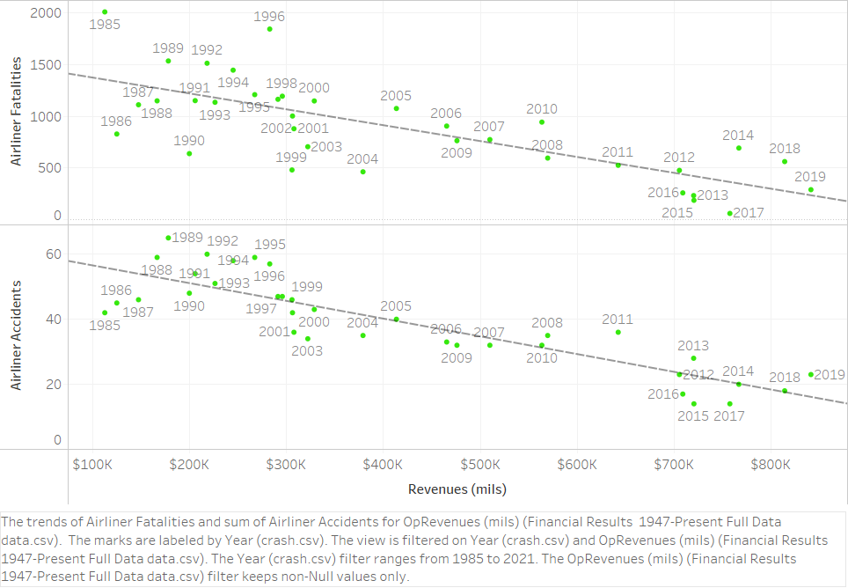
Industry Numbers
Lower fatalities/accidents appears to be related with higher revenue.
Trend may be mainly caused by time. Both safety and revenue improve over the years.

Slide 3
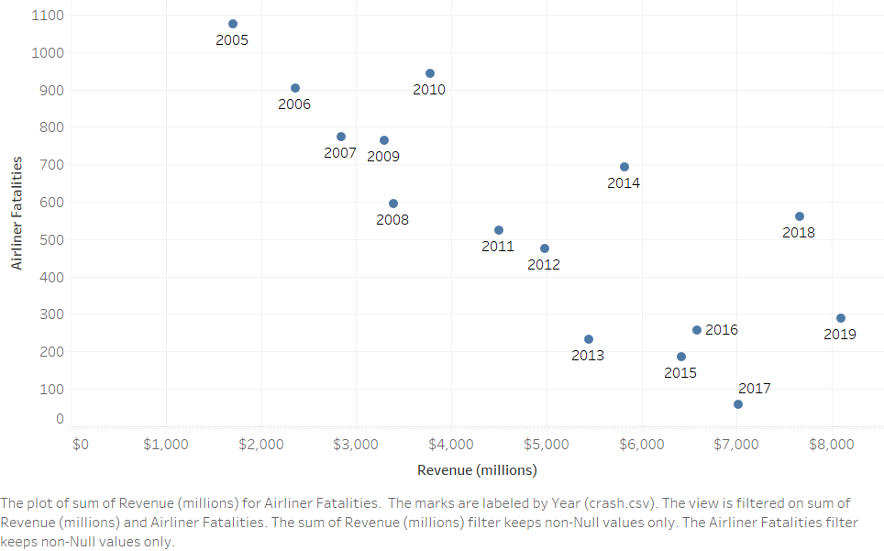
Company Numbers
Trend for company mirror industry trends.
Continued growth over time, despite years with higher fatality rates.

Slide 4

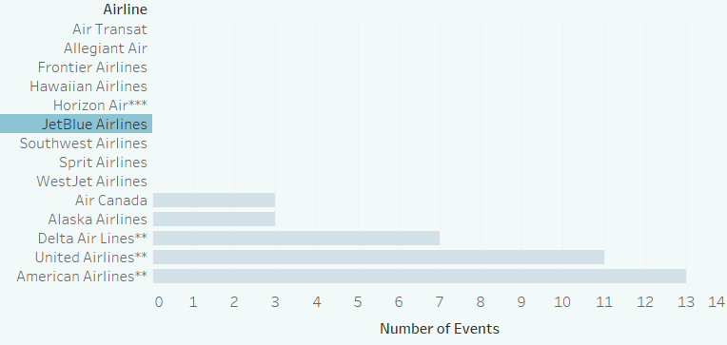
Number of Events with more than 1 Fatality since 1970 No JetBlue events since 1970

Slide 5
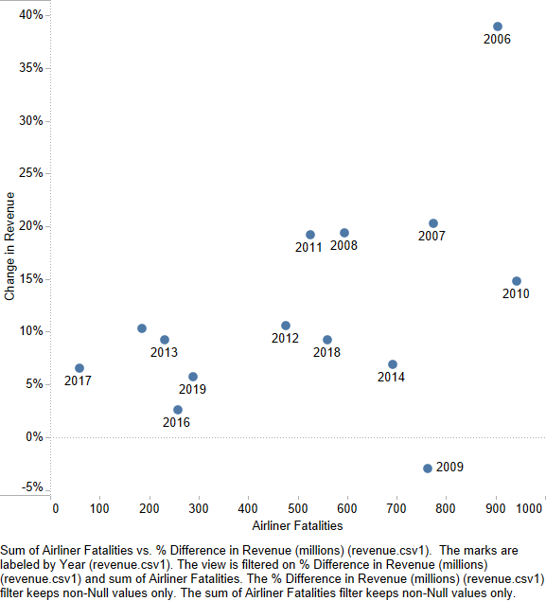
JetBlue Year to Year Change
Percent change from year to year has greater fluctuation than revenue.
There does not appear to be a negative relationship between fatalities and percent change.

Slide 6
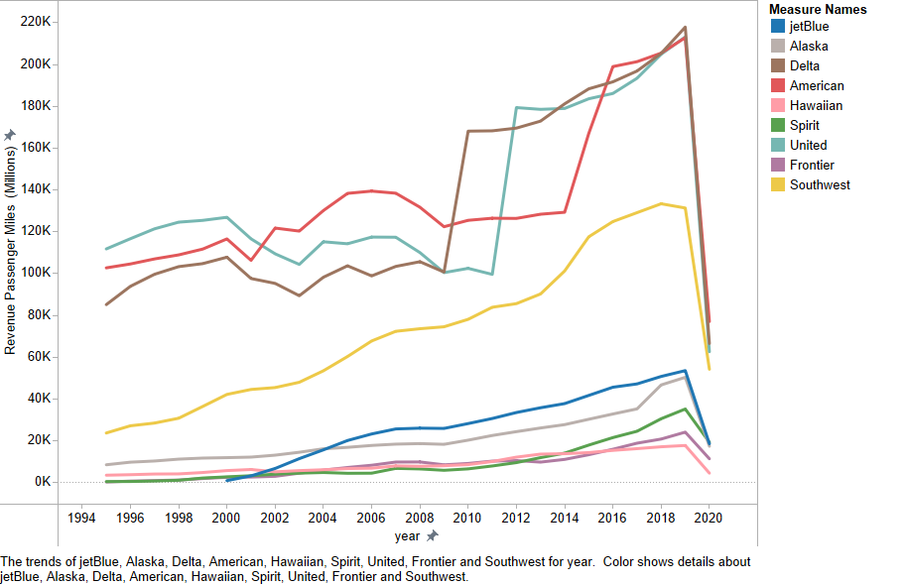
Current Standings
Passenger Revenue Miles (PRM) have increased steadily for JetBlue.
In 2019 JetBlue flew 53,620,000,000 PRM.

Slide 7
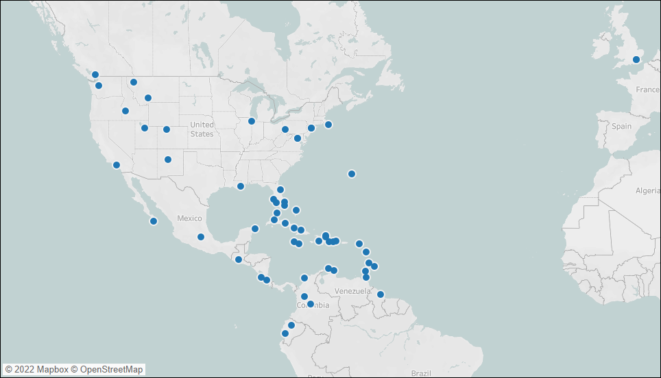
Brief view of JetBlue’s range.

Slide 8
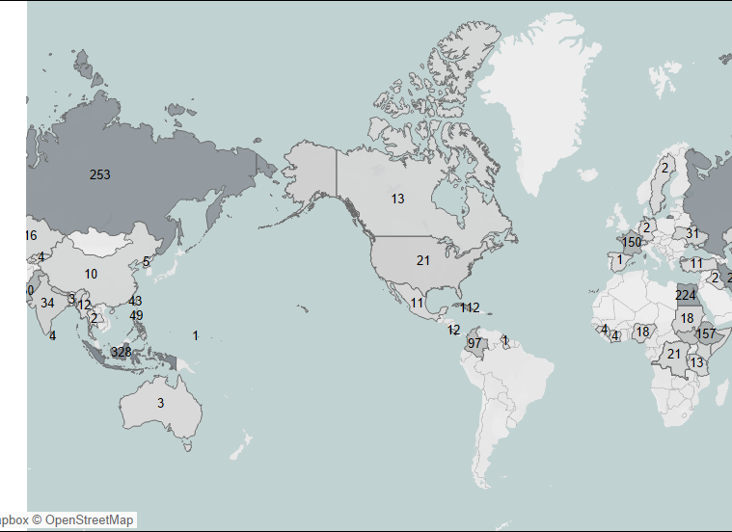
Fatalities by Country
Fatality numbers since 2015
Circle indicates area serviced by JetBlue (plus London).
Cuba and Colombia are the only countries with more than 25 fatalities over the past 6 years.

Slide 9
Summary
Revenue continues to rise over time. Fatalities have been dropping.
Any effect on revenue appears very minor.
01
JetBlue has not had any incidents resulting in death.
02
Area serviced by JetBlue has lower fatality rates overall.
03

Slide 10
Data retrieved from:
http://www.airsafe.com/airline.htm
https://www.macrotrends.net/stocks/charts/JBLU/jetblue-airways/revenue
http://web.mit.edu/airlinedata/www/2020%2012%20Month%20Documents/Traffic%20and%20Capacity/System%20Total/Total%20System%20Revenue%20Passenger%20Miles.htm
https://en.wikipedia.org/wiki/List_of_JetBlue_destinations
https://aviation-safety.net/statistics/period/stats.php?cat=A1
https://aviation-safety.net/

